Slide 1
ASM NGS Pre Conference NCBI Workshop
We have muted all participants when first joining the zoom
https://github.com/NCBI-Codeathons/asm-ngs-workshop
slack:
asm-ngs-workshop
#general - if you have technical issues, please post them there
https://join.slack.com/t/asm-ngs-workshop/shared_invite/zt-jfx7s4zb-lLBdpumiEdr0INIzUaJKIA
Open an "Incognito window"
Go to https://console.cloud.google.com

Slide 2
ASM NGS Pre Conference NCBI Workshop
Hosted by NCBI Pathogen Detection Team

Slide 3
Brief 4 hour introductory workshop
Basic intro to cloud (GCP)
Using a published paper dataset in order to
introduce NCBI cloud tools and data access
https://github.com/NCBI-Codeathons/asm-ngs-workshop

Slide 4
Setup
login to GCP
create a VM and launch and log into the VM
create a cloud storage bucket
configure SRA Toolkit configuration
configure authorization

Slide 5
In order to do this you will probably need the following open and visible on the screen at the same time
1. The github page open with the steps to follow OR the zoom page when we are showing slides
AND
2. Either the console.cloud.google.com webpage, OR the terminal once you have logged in

Slide 6
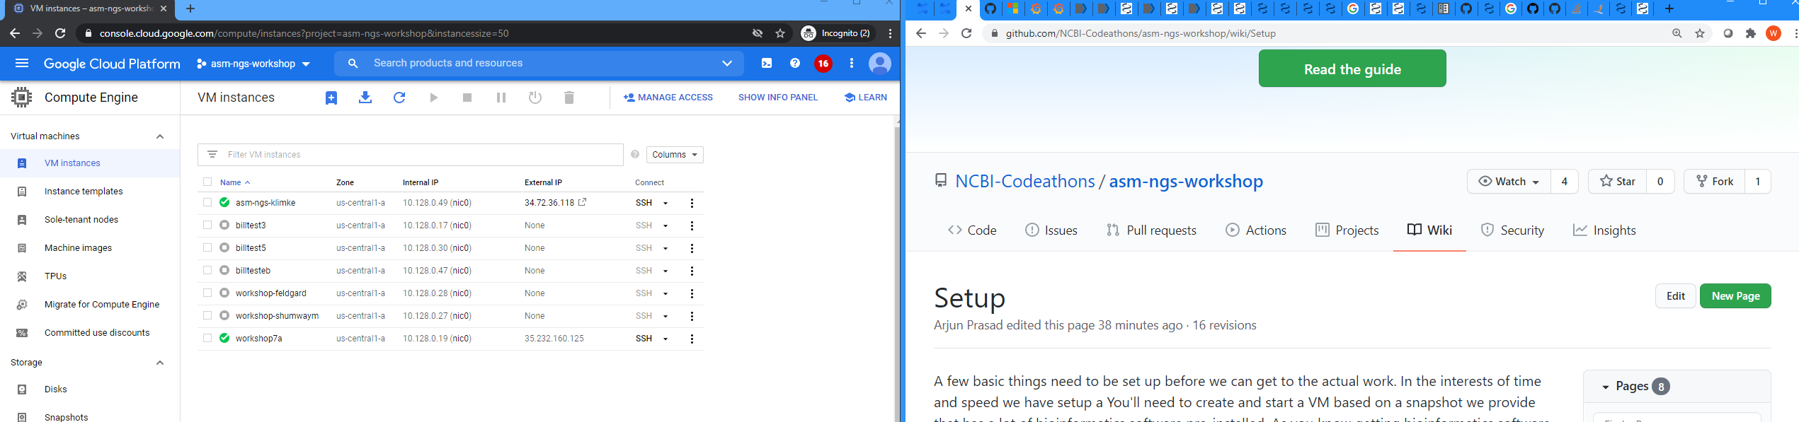
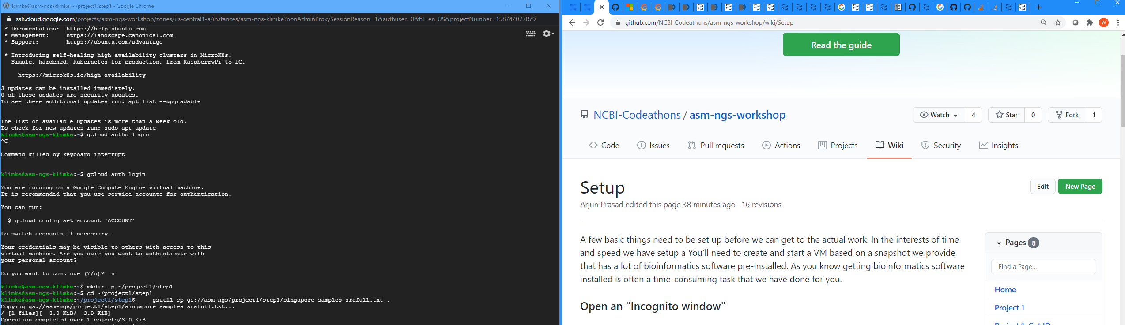

Slide 7
Either follow along in Zoom
OR
follow in setup pages in Github
https://github.com/NCBI-Codeathons/asm-ngs-workshop/wiki/Setup

Slide 8
Back to GCP console for setup

Slide 9
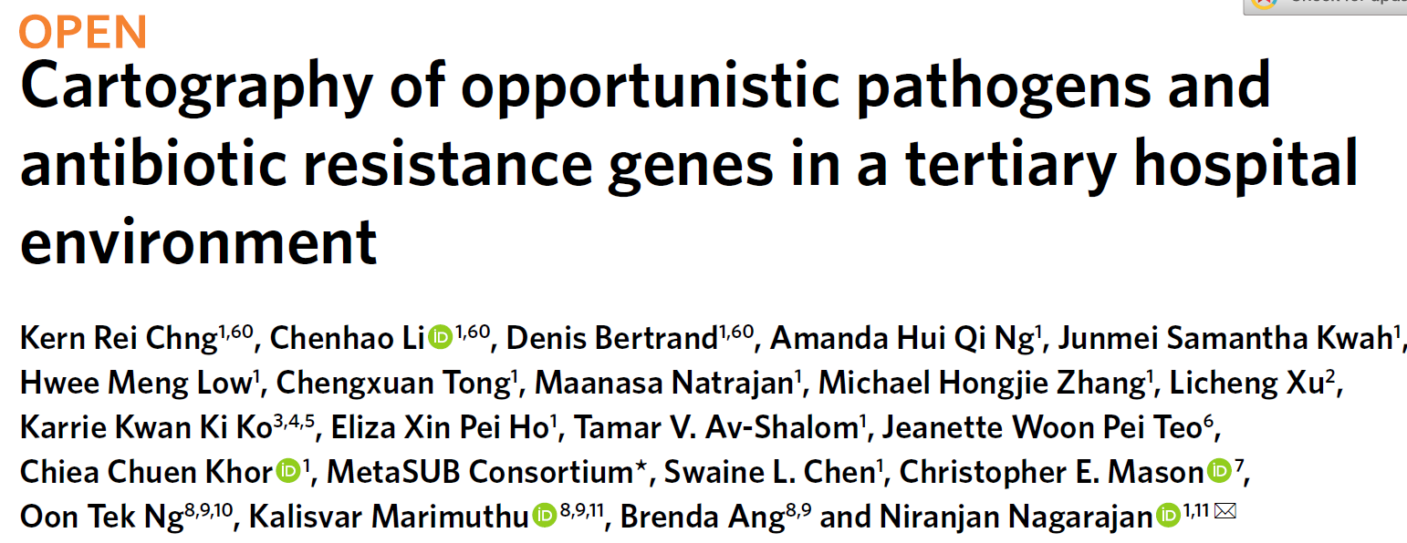
Background to analysis steps
https://pubmed.ncbi.nlm.nih.gov/32514171/
doi: 10.1038/s41591-020-0894-4

Slide 10
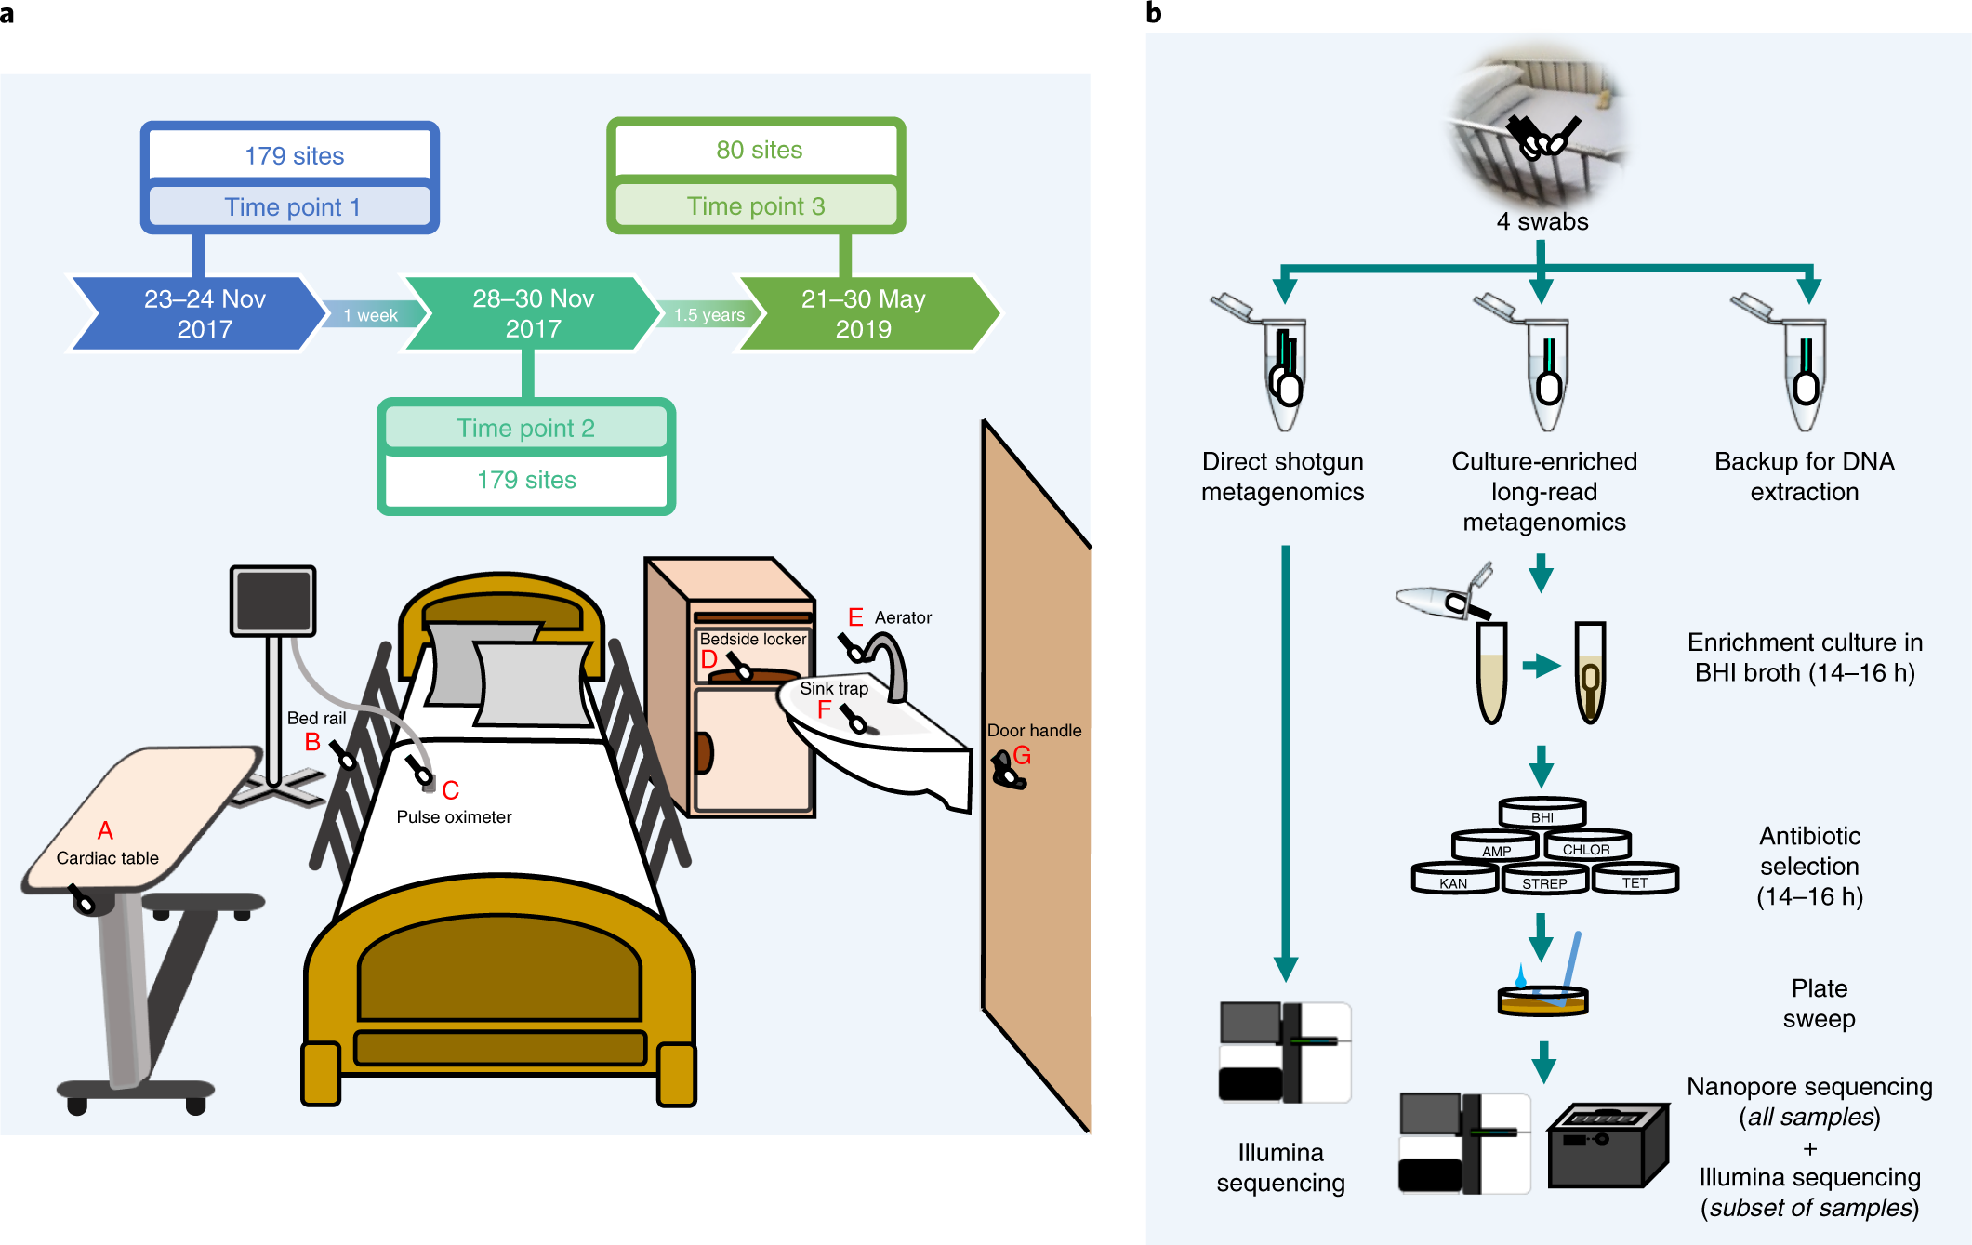
Sampling in a tertiary care hospital
multiple floors, wards, rooms,
sites samples
two time points one week apart,
deep metagenomics sequencing
with Illuumina
a subset of sites sampled a third
time a year later
did taxonomic and antibiotic
resistance gene analysis (ARG)
used ARG analysis to aid
enrichment culture for nanopore
sequencing
Figure 1. Overview of sampling sites and analysis workflow. Chng, et al. 2020

Slide 11
Background to the analysis section.
Using data from this paper:
From enrichment cultures did nanopore sequencing (all samples) and illumina (subset)
Nanopore-based metagenomic assemblies were high quality and could be assigned to specific taxa
Illumina assemblies were lower quality
Characterized plasmid sequences from assemblies and ARGs, and noted same plasmid in multiple environments.
Analyzed relationships between genomes using ANI and noted ARG and cluster stability over time
Noted some very clonally related isolates (Elizabethkingia) and more distally related (S. aureus) both
patient and environment and from a different study years earlier (also found antibiotic resistance was enriched),
and A. baumannii patient and environment and relationship to Kuwaiti isolates from a separate published study

Slide 12
We will examine three areas
1. For the Acinetobacter isolates for which antibiotic susceptibility testing has
been done
a. assemble the Illumina data with SKESA
b. run AMRFinderPlus on the assemblies
c. compare the AST data from the paper to the ARGs from AMRFinder
2. For the Acinetobacter s6 cluster, compare to the Kuwaiti isolates
a. Use Pathogen Detection to examine and obtain Kuwaiti isolates genomes
b. Use metadata for the s6 cluster to pull out genomes from the s6 set
c. compare using MUMMER and parsnp

Slide 13
3. From a set of metagenomic samples
a. select interesting examples based on reported Resistome
b. from set of assembled plasmid, select interesting plasmids
c. pull out reads from a using b as reference and tool readfinder
d. assemble reads from c using b as reference using saute
e. compare assembled plasmid against reference plasmid
f. identify shared plasmids in different metagenomic samples

Slide 14
Project 1
For the Acinetobacter isolates for which antibiotic susceptibility testing has
been done
a. assemble the Illumina data with SKESA
b. run AMRFinderPlus on the assemblies
c. compare the AST data from the paper to the ARGs from AMRFinder

Slide 15
SKESA - de novo assembler
dsub - tool for managing parallelization via google cloud
APIs

Slide 16
SKESA: Strategic Kmer Extension for Scrupulous Assemblies
The difference between the strains could be as small as a handful of SNPs.
Most assemblers are optimized for the contig length and will make ‘risky’ connection.
Most experiments are conducted using Illumina machines.
Low-level contamination from a very similar strain is almost always present -- sequencing and/or sampling protocols may be the cause.
Souvorov et al., 2018. doi: 10.1186/s13059-018-1540-z

Slide 17
56 bio-samples with PacBio assembly and Illumina reads (used as validation set)
QUAST: quality assessment tool for genome assemblies, Bioinformatics, 2013 Apr 15.
Assembler | SKESA | SPADes | Megahit
Avg time (12 cores) | 362 s | 1,236 s | 283 s
SKESA is fast because it is conservative
there may be more breaks in the assembly, but less mismatches overall
https://github.com/ncbi/SKESA

Slide 18
dsub
dsub is a command-line tool that makes it easy to submit and run batch scripts in the cloud.
The dsub user experience is modeled after traditional high-performance computing job schedulers like Grid Engine and Slurm. You write a script and then submit it to a job scheduler from a shell prompt on your local machine.
It can be exercised in local mode to allow rapid prototyping without incurring costs.
It uses the Google Cloud Life Sciences API for running tasks.
Requires storage buckets for input/output data files.
Can run docker images, or home built scripts.
https://github.com/DataBiosphere/dsub
https://cloud.google.com/life-sciences/docs/reference/rest

Slide 19
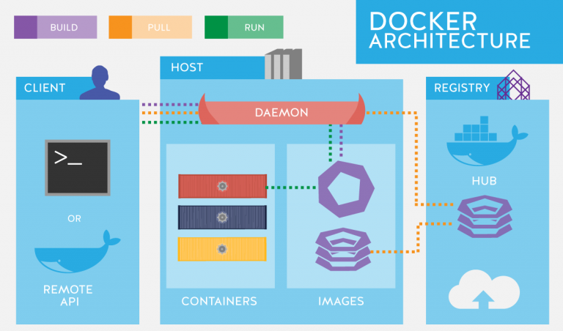
Docker
Dockerhttps://thingsolver.com/hello-docker/

Slide 20
Docker
Docker Engine is an open source containerization technology for building and containerizing your applications.
Many Docker images already exist for life sciences tools
Anyone can create a Docker image (with account)
https://docs.docker.com/engine/

Slide 21
For this workshop we are using
1. a docker image that contains SKESA
2. a tab-delimited text file that contains inputs and outputs pointing to a storage bucket
3. dsub to issue the command and handle communication to google cloud APIs for managing tasks
4. that we copy into a script and then execute the script

Slide 22
Back to Github

Slide 23
AMRFinderPlus

Slide 24
Large Scale Requires Concise Information
hundreds of genomes per day
can’t be ‘artisanal’; flipping through multiple columns/rows/tables will not work
Need concise, discrete signifier that conveys appropriate information about genotype (and possibly phenotype)
Contact us at pd-help@ncbi.nlm.nih.gov

Slide 25
That signifier is the gene symbol
blaKPC-2 (KPC-2) is a shorthand for gene function:
“carbapenem-hydrolyzing class A beta-lactamase KPC-2”
Need to specify precisely what we do and do not know:
blaKPC-2, blaKPC, and bla do not mean the same thing
We do not want to:
overspecify: claim KPC-2 when only KPC-family
underspecify: claim KPC-family when KPC-28
misclassify: call KPC-2 as KPC-28
For AMR genes, we have developed AMRFinderPlus to identify AMR genes in genomic data

Slide 26
AMRFinderPlus Uses a Curated Database, HMMs and BLAST to Identify AMR genes
Proteins
Nucleotide
Report on
resistance genes
- integrated into Pathogen Detection Isolate Browser for >672,000 pathogen isolates
Available at:
https://github.com/ncbi/amr/wiki
HMMs and
BLAST
AMR
database
”Plus” contains:
631 virulence factors
218 acid, biocide, metal, and heat resistant genes
Optional for users
5,662 resistance proteins
> 610 HMMs
44 drug classes resisted
~60% beta-lactamases
AMRFinderPlus now finds point mutations!
682 resistance mutations for seven taxa including Campylobacter, E. coli, and Salmonella
https://github.com/ncbi/amr/wiki

Slide 27
AMRFinderPlus Overview Hierarchical Structure
Functional determination
Protein name
Resistance to carbapenems and other beta-lactam antibiotics.
Exact match
KPC-2
Proteins
(or DNA)
HMM score > cutoff of KPC family
KPC family
Likely resistance to carbapenems and other beta-lactam antibiotics.
HMMs* and
BLAST
Report on
resistance genes
in isolate
AMR
database
HMM score > cutoff
class A β-lactamase
Class A beta-lactamase of unknown specificity.
Prevents false-positive identification as a beta-lactamase. Not reported.
HMM score > cutoff
not beta-lactamase
Protein name
Protein name
Protein name
Functional determination
Exact match
Resistance to carbapenems and other beta-lactam antibiotics.
Exact match
KPC-2
Resistance to carbapenems and other beta-lactam antibiotics.
Exact match
KPC-2
Resistance to carbapenems and other beta-lactam antibiotics.
KPC-2
HMM score > cutoff of KPC family
KPC family
Likely resistance to carbapenems and other beta-lactam antibiotics.
HMM score > cutoff of KPC family
KPC family
Likely resistance to carbapenems and other beta-lactam antibiotics.
HMM score > cutoff of KPC family
KPC family
Likely resistance to carbapenems and other beta-lactam antibiotics.
HMM score > cutoff
class A β-lactamase
Class A beta-lactamase of unknown specificity.
HMM score > cutoff
class A β-lactamase
Class A beta-lactamase of unknown specificity.
HMM score > cutoff
class A β-lactamase
Class A beta-lactamase of unknown specificity.
not beta-lactamase
Prevents false-positive identification as a beta-lactamase. Not reported.
not beta-lactamase
Prevents false-positive identification as a beta-lactamase. Not reported.
not beta-lactamase
Prevents false-positive identification as a beta-lactamase. Not reported.

Slide 28
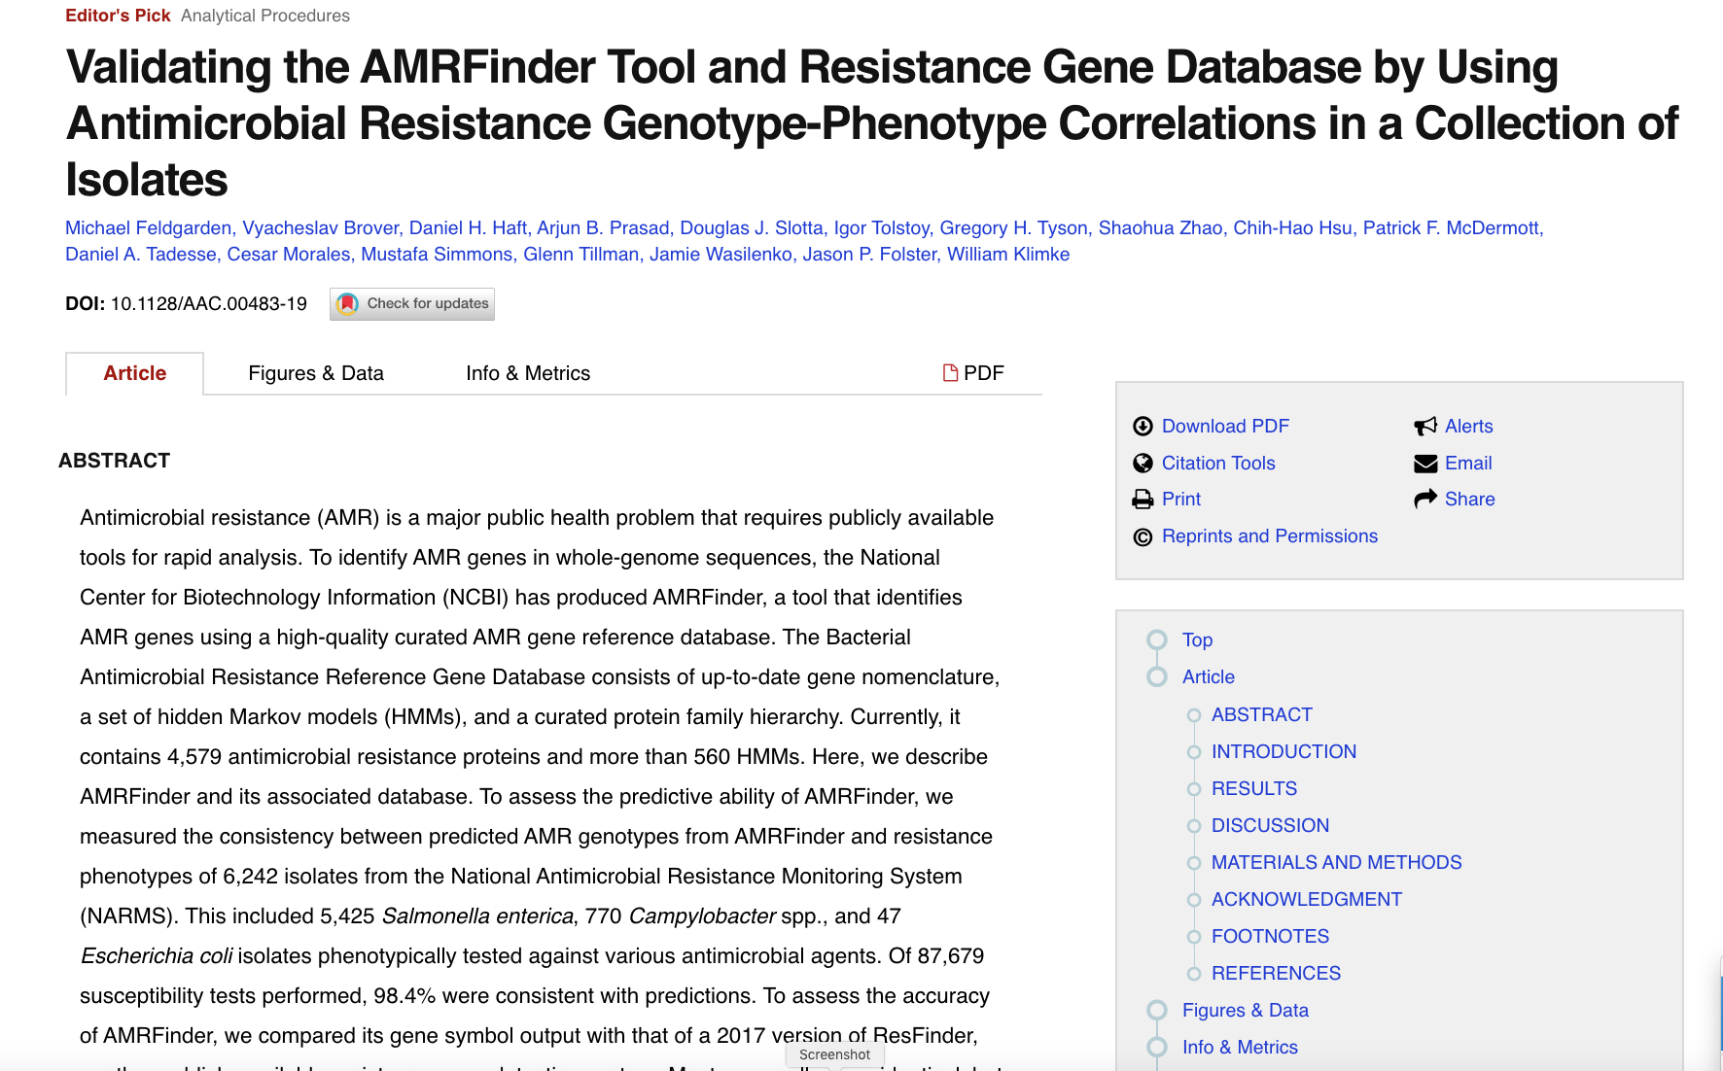
https://www.ncbi.nlm.nih.gov/pubmed/31427293
pd-help@ncbi.nlm.nih.gov

Slide 29
Back to Github

Slide 30
Technical steps for genotype/phenotype
1. obtain the Resistome data for the Acinetobacter isolates from the supplementary file
2. predict phenotypes from our AMRFinderPlus results on the assembled Acinetobacter genomes
using subclass info (specific field in the results)
3. compare the actual resistance phenotypes from the paper to our predicted phenotypes and report
the discrepancies

Slide 31
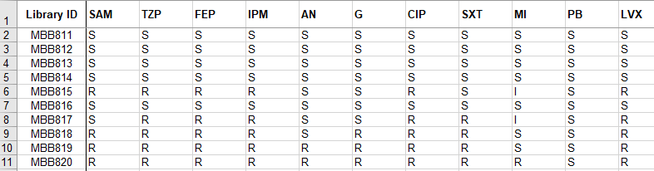
Reported resistance for Acinetobacter isolates from paper
columns are antibiotics
rows are isolates/genomes
cells are S/I/R antibiotic susceptibility calls

Slide 32
How We Are Predicting AMR in These Isolates
Using AMRFinderPlus to identify AMR genes
Run with --plus option, which enables efflux pump detection, and and –organism Acinetobacter option, which enables Acinetobacter point mutation detection
SUBCLASS and the product name are used to determine resistance to antibiotics:
Ampicillin-sulbactam (SAM): subclasses include BETA-LACTAM, CEPHALOSPORIN, CARBAPENEM; check for inhibitor-resistant in product name (certain classes might not require inhibition resistance, e.g., blaNDM)
Piperacillin-tazobactam (TZP): subclasses include BETA-LACTAM, CEPHALOSPORIN, CARBAPENEM; check for inhibitor-resistant in product name (certain classes might not require that, e.g., blaNDM)
Cefepime (FEP): subclasses include CEPHALOSPORIN, CARBAPENEM
Imipenem (IPM): subclass CARBAPENEM
Amikacin (AN): subclass should include AMIKACIN
Gentamicin (G): subclass should include GENTAMICIN
Trimethoprim-sulfamethoxazole (SXT): subclass should include TRIMETHOPRIM and SULFONAMIDE
Minocycline (MI): subclass should include TETRACYCLINE
Polymyxin B (PB): subclass should include COLISTIN (not found in exercise)
Levofloxacin (LVX): subclass should include QUINOLONE

Slide 33
The Biology of AMR Resistance in Acinetobacter (in 1 slide…)
Other organisms, such as enterics, have a very high concordance (Feldgarden et al., 2019; PMID:31427293), but not Acinetobacter (e.g., Van Camp et al., PMID:32528441):
Efflux pumps
differential expression of efflux pumps can affect resistance phenotypes (e.g., adeRS mutations)
Silent beta-lactamases–cephalosporinases and carbapenemases that are not expressed:
Point mutations in promoters
IS element insertion in promoters
Upstream regulation
Also can have combination of efflux pump + weak activity beta-lactamase (also found in other MDR organisms, such as Enterobacter)

Slide 34
AMR Analysis Summary
 | Predicted R | Predicted S
Observed R | 292 | 189
Observed S | 109 | 576
Adding efflux pumps (“EFFLUX” under subclass) lowers the very major errors, but increases the major errors:
all 51 SXT resistant isolates that are called as susceptible would be 'fixed', but 48 SXT susceptible isolates then would predicted to be resistant.
All 31 AN resistant isolates that are predicted susceptible vanish, but 60 AN isolates susceptible isolates then would predicted to be resistant.
This means you can’t ‘plug and chug’ the analysis for some organisms
Additional analysis and benchwork needed
We need more genomes with susceptibility data to improve genome-based prediction
PPV = 0.73
NPV = 0.75
The 189 very major errors are mostly amikacin and trimethoprim-sulfamethoxazole (1 FEP, 31 AN, 1 G, 51 SXT, 49 SAM, 56 TZP)
The 109 major errors are distributed across the beta-lactamases and minocycline (1 AN, 51 FEP, 2 G, 36 IPM, 19 MI)
grep BETA-LACTAM ~/project1/step5/amrfinder/ERR3653785.amrfinder
Will see two beta-lactamases, one is a cephalosporin and one is a carbapenemase
grep ERR3653785 ~/project1/step6/disagreements.tab
These are phenotypically susceptible, but predicted resistant

Slide 35
Two Examples of Prediction Errors
grep BETA-LACTAM ~/project1/step5/amrfinder/ERR3653785.amrfinder
Will see two beta-lactamases, one is a cephalosporin and one is a carbapenemase
grep ERR3653785 ~/project1/step6/disagreements.tab
These are phenotypically susceptible, but predicted resistant

Slide 36
Summary: Project 1
In this project we introduced:
Step1. Using SRA toolkit to quickly access SRA data
Step2. Assembling using SKESA and dsub
Step3. Run AMRFinderPlus on the assemblies to obtain the genotypes for the assemblies
Step4. Obtain AST data from the paper
Step5. Predict phenotypes from AMRFinderPlus based on subclass
Step6. Compare predicted vs. real phenotypes and list the discrepancies
Discuss issues with genotype/phenotype predictions

Slide 37
Biobreak ~ 10 minutes
Back at 10:40 AM EDT

Slide 38
Project2. For the Acinetobacter s6 cluster, compare to the Kuwaiti isolates
a. Use Pathogen Detection to examine and obtain Kuwaiti isolates genomes
b. Use metadata for the s6 cluster to pull out genomes from the s6 set
c. compare using MUMMER and parsnp

Slide 39
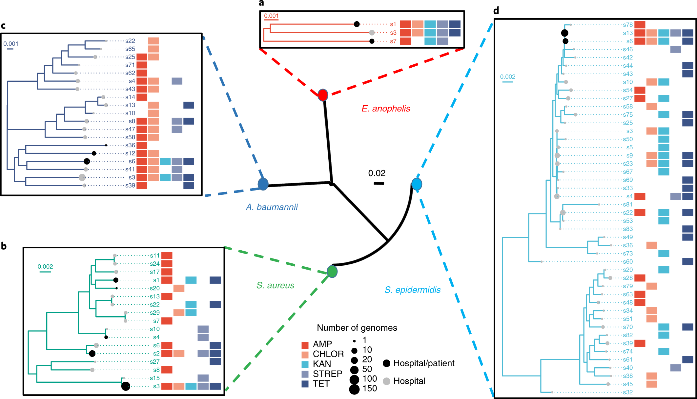
We will examine this cluster (part 2, see below)
leaf nodes reflect
clusters of related
genomes, not
individual isolate
genomes
Figure 5. Multispecies analysis of phylogenetic relationships between environmental
and patient genomes. Chng, et al. 2020

Slide 40
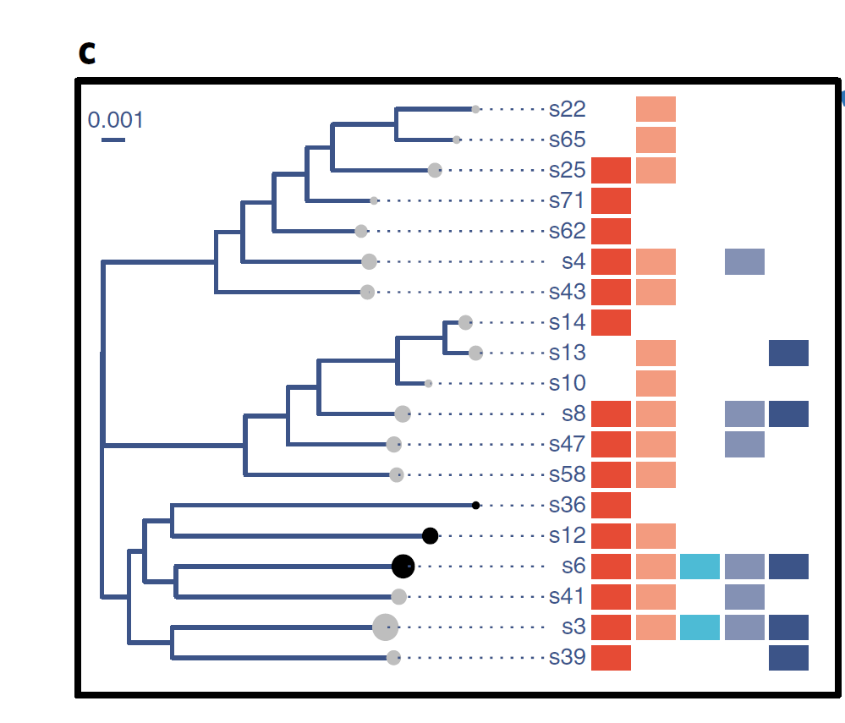
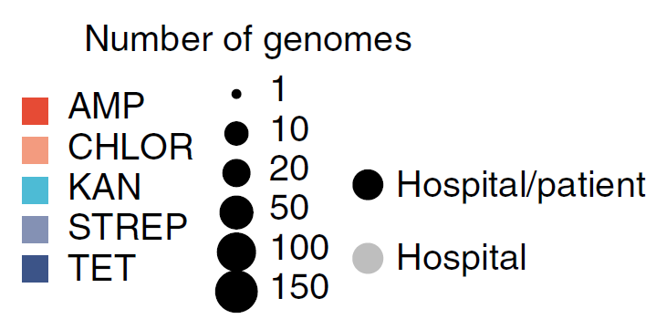
s6 cluster of 27 genomes
Figure 5. Multispecies analysis of phylogenetic relationships between environmental
and patient genomes. Chng, et al. 2020

Slide 41
To extend these observations, A. baumannii patient isolates
(n = 108) from a hospital surveillance cohort in Singapore established
>8 years ago were sequenced. Many isolate genomes from
this cohort had high identity to our environmental genomes (s6,
99.995% ANI) while being temporally separated by almost a
decade. ... Extending to a regional
context, analysis of A. baumannii patient isolates (n = 36) from two
major Kuwaiti hospitals51 with our environmental genomes (Fig. 5c)
identified a shared derivative cluster resistant to all five antibiotics,
including Singaporean and Kuwaiti patient isolate genomes at
high identity (s6, >99.99% ANI).
There is a statement in the paper that isolates from this Singapore hospital are related to Kuwaiti patient
isolates from a separate study.

Slide 42
The s6 isolates mentioned in the paper are actually identified in the metadata files on
the github site created by the author
WHILE
The actual FASTA sequences are available on the figshare site created by the authors
NONE of this is available at INSDC
To obtain the s6 files
1. clone the github site
2. get the genome ids from a particular file
3. obtain the FASTA file from figshare for the hybrid assemblies
4. use the IDs from #2 and the files in #3 to put together the list of s6 genomes

Slide 43
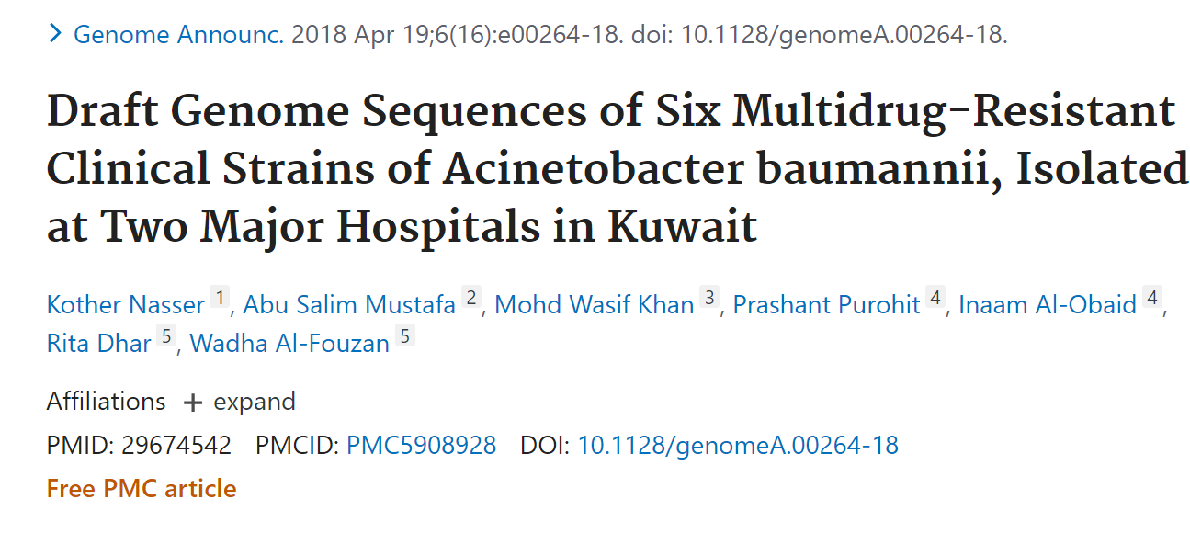
The data for this paper are already published in this BioProject
https://www.ncbi.nlm.nih.gov/bioproject/PRJNA380997
And are already integrated into Pathogen Detection
https://www.ncbi.nlm.nih.gov/pathogens/isolates/#PRJNA380997

Slide 44
Analysis goals of Pathogen Detection pipeline
Are these isolates clonally related?
What is the anti-microbial resistance, stress response, and virulence gene repertoire of this isolate
Analysis pipeline is completely automated, does not require human interaction
Both results presented in easy to use integrated web-interface

Slide 45
Pathogen Detection Pipeline (basics)
Lab
submission
SRA
Assembly
Annotation
Clustering/Neighbors
GenBank
AMRFinderPlus
Rapid reports (on FTP < 60 minutes after submission - select organisms and BioProjects only)
All 33 taxa
Clusters
Trees for each Clusters
AMR Genes per Isolate
(in web interface and FTP < 24 hours after submission)
Notes:
GenBank

Slide 46
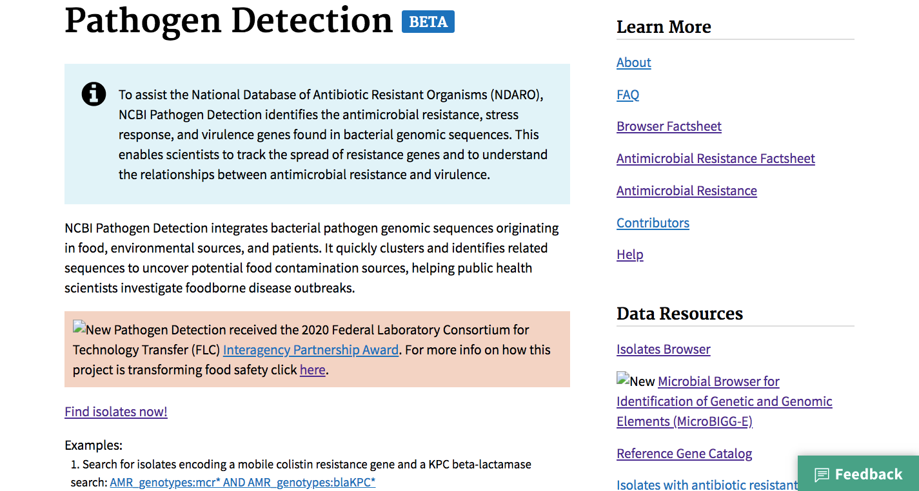
https://www.ncbi.nlm.nih.gov/pathogens/

Slide 47
None of these Kuwaiti isolates from this paper are themselves found within a SNP cluster
by the Pathogen Detection pipeline (~25 wgMLST allele distance)
Therefore, how closely related are they really to the s6 cluster in the Singapore paper?

Slide 48
Back to Github

Slide 49
Rough SNP calculation
The paper uses MUMMER to assembly to assembly comparison
We mimic that by the following steps
1. run nucmer to generate pairwise comparisons
2. parse the output file to generate a pairwise SNP file
3. roughly parse the SNP file to filter for
3a. dense SNP regions
3b. SNPs near contig ends

Slide 50
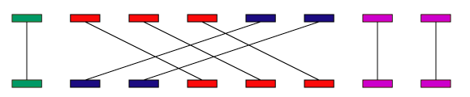
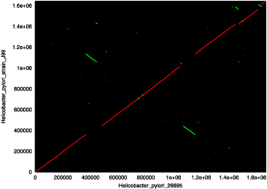
MUMmer is an open source software package for the rapid alignment of very large DNA and amino acid sequences.
Convenient in that it allows assembly-assembly comparison
Produces convenient output files
http://mummer.sourceforge.net/manual/

Slide 51
there are two convenient numbers provided that allow easy filtering
[BUFF] distance from this SNP to the nearest mismatch (end of alignment, indel, SNP, etc) in the same alignment
[DIST] distance from this SNP to the nearest sequence end
near end of contig
[P1] [SUB] [SUB] [P2] [BUFF] [DIST] [FRM] [TAGS]
1552619 A C 13 13 13 1 -1 opera_contig_3287_N134_BC08 NEOV01000018.1
160460 T C 66276 3 35981 1 1 opera_contig_3288_N134_BC08 NEOV01000013.1
160463 C T 66279 3 35978 1 1 opera_contig_3288_N134_BC08 NEOV01000013.1
160496 G A 66312 3 35945 1 1 opera_contig_3288_N134_BC08 NEOV01000013.1
160499 G A 66315 3 35942 1 1 opera_contig_3288_N134_BC08 NEOV01000013.1
160505 A C 66321 6 35936 1 1 opera_contig_3288_N134_BC08 NEOV01000013.1
160511 C T 66327 6 35930 1 1 opera_contig_3288_N134_BC08 NEOV01000013.1
160520 T C 66336 3 35921 1 1 opera_contig_3288_N134_BC08 NEOV01000013.1
160523 T A 66339 3 35918 1 1 opera_contig_3288_N134_BC08 NEOV01000013.1
these SNPs are clustering in a very small region
could be alignment problem
could be recombination
both need to be filtered for accurate assessment

Slide 52
However, this step resulted in identification of an issue with an assembly of ~75% avg. genome size
We skipped assembly QC in the first project but it is always a critical step in data assessment
Typical metrics include
1. assembly size
2. contig count
3. N50
4. average nucleotide identity (NCBI PGAP tool does this)
5. some other assessment of contamination
And the above are context dependent for the species under investigation. Obviously these are hybrid assemblies
put together from a metagenomics dataset and are not the same as a pure cultured isolate.

Slide 53
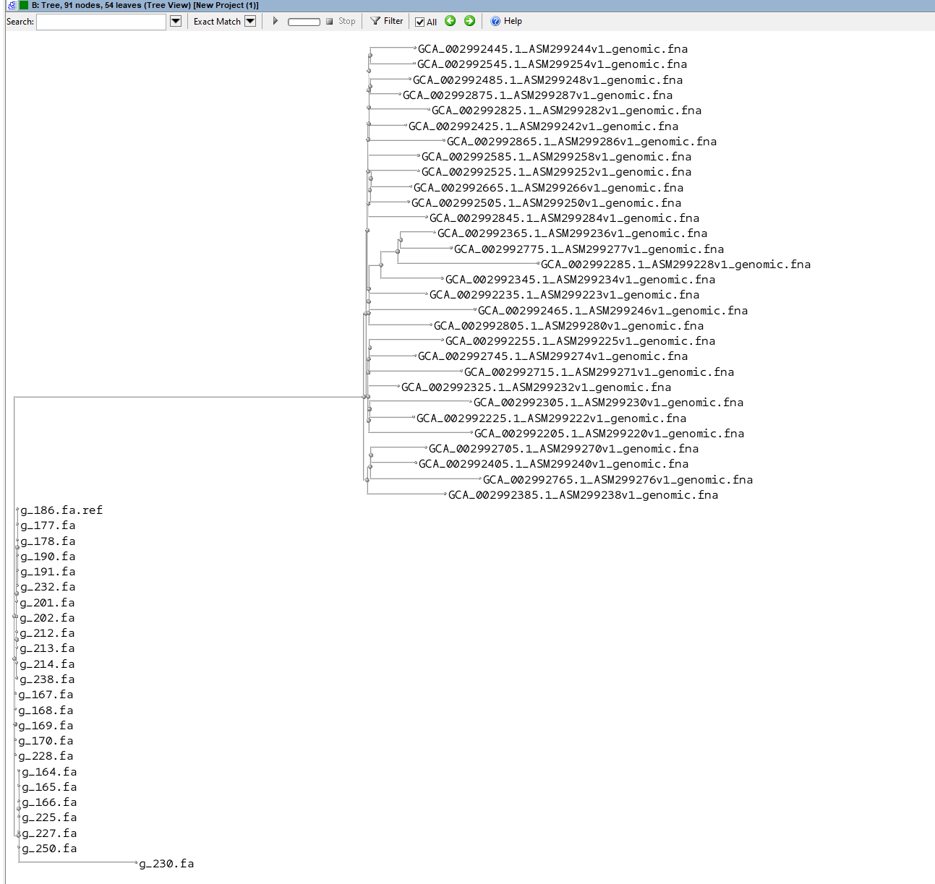
After filtering outlier genomes
(one based on size, the rest based on
SNP distances > 1000) and then
generating a phylogenetic tree
using parsnp, you end up with two distinct
clades

Slide 54
...including Singaporean and Kuwaiti patient isolate genomes at
high identity (s6, >99.99% ANI).
4 Mb gnome - (4 Mb genome X 0.9999) = 400 SNPs
The ANI range is the same order of magnitude we found for our SNP distances
These isolates ARE related, but they are NOT clonal

Slide 55
The Pathogen Detection project does not currently include metagenomic derived assemblies
If cultured isolate sequences were submitted, we could have included them in the system, then all of the above
steps could have been done by simply clicking on a web page

Slide 56
Summary: Project 2
In this project we introduced:
Step1. Review the phylogenetic tree in Figure 5 of the paper, s6 cluster of A. baumannii
Step2. Obtain the Singapore s6 cluster genome sequences from the data files from the paper
Step3. Obtain the Kuwaiti patient isolate genomes from Pathogen Detection
Step4. Compare the s6 to Kuwaiti isolates using mummer and parse the SNPs, identify problem cases and determine
actual distances between the two datasets

Slide 57
Project3. From a set of metagenomic samples
a. select interesting examples based on reported Resistome
b. from set of assembled plasmid, select interesting plasmids
c. pull out reads from a using b as reference and tool readfinder
d. assemble reads from c using b as reference using saute
e. compare assembled plasmid against reference plasmid
f. identify shared plasmids in different metagenomic samples

Slide 58
Reported Resistome of Metagenomics Samples from Paper
Antibiotic resistance gene | WEE037 | WEE039 | WEE120 | WEE125 | WEE237
OXA-1_Bla | 1 | 1 | 1 | 1 | 0
DHA_Bla | 1 | 0 | 1 | 0 | 0
MECA_Bla | 1 | 0 | 0 | 0 | 0
OXA-48_Bla | 1 | 1 | 0 | 0 | 0
CTX-M-1_Bla | 1 | 1 | 0 | 0 | 0
we used the table from the paper to select several interesting cases, high count of genes, or select genes
(the above list is filtered for beta lactamases, present in first sample)

Slide 59
Reported Metadata of Metagenomics Samples from Paper (combined from multiple sources)
Date of Collection | Sample ID | Timepoint | Hospital Floor | Ward Type | Ward/Room Number | Sample Type | Bed Number | Surface Material | Illumina Library ID | SRR
2017-11-28 | HMBR127_02 | 2 | 8 | Isolation room | 3 | Bed Rail |  | Plastic | WEE037 | ERR3209766
2017-11-24 | HMBR133 | 1 | 11 | Isolation room | 5 | Bed Rail |  | Plastic | WEE039 | ERR3209768
2017-11-23 | HMBL103 | 1 | 7 | Standard | 3 | Bedside Locker | 5 | Wood | WEE120 | ERR3209849
2017-11-28 | HMA001_02 | 2 | 7 | MDRO | 1 | Aerator |  | Metal | WEE125 | ERR3209854
2017-11-24 | HMST007 | 1 | 9 | MDRO | 3 | Sink Trap |  | Metal | WEE237 | ERR3209966

Slide 60
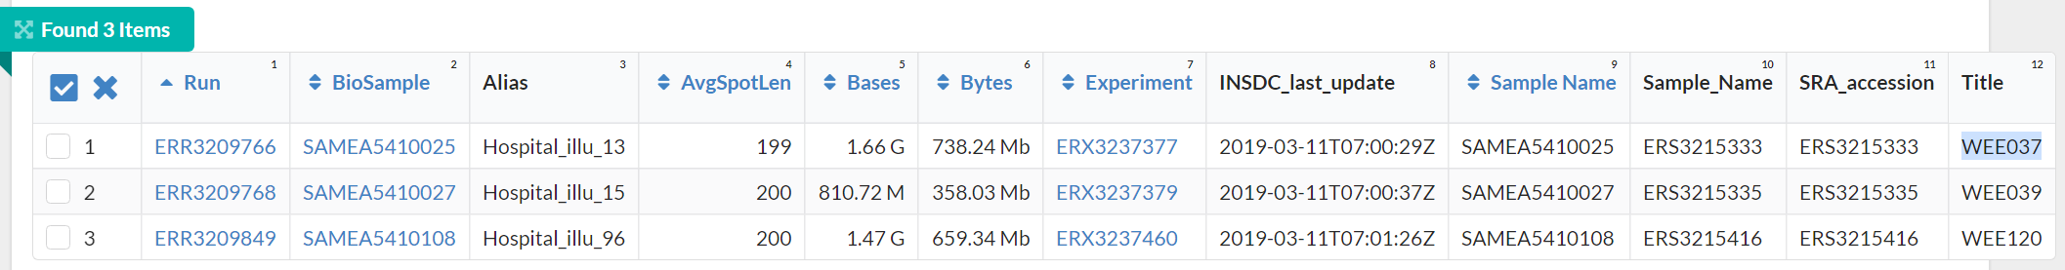
BioProject | PRJEB31632
Consent | PUBLIC
Assay Type | WGS
Center Name | GENOME INSTITRUTE OF SINGAPORE
DATASTORE filetype | FASTQ, SRA
DATASTORE provider | ENA, GS, NCBI, S3
DATASTORE region | ena, gs.US, ncbi.public, s3.us-east-1
ENA_checklist | ERC000011
ENA-FIRST-PUBLIC | 5/22/2019
ENA-LAST-UPDATE | 3/11/2019
INSDC_center_alias | GENOME INSTITRUTE OF SINGAPORE
INSDC_center_name | GENOME INSTITRUTE OF SINGAPORE
INSDC_first_public | 2019-05-22T17:03:34Z
INSDC_status | public
Instrument | Illumina HiSeq 2000
Library Name | unspecified
LibraryLayout | PAIRED
LibrarySelection | RANDOM
LibrarySource | METAGENOMIC
Organism | metagenome
Platform | ILLUMINA
ReleaseDate | 5/23/2019
SRA Study | ERP114207
Metadata in SRA

Slide 61
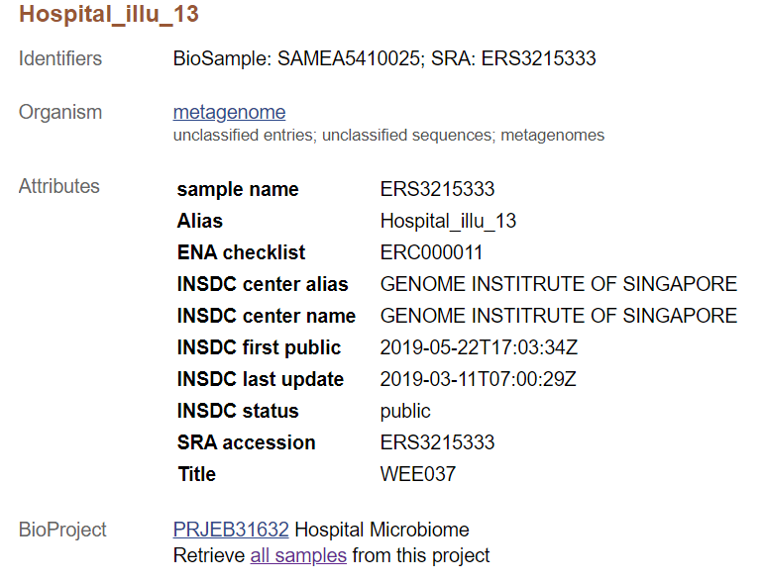
Metadata in BioSample

Slide 62
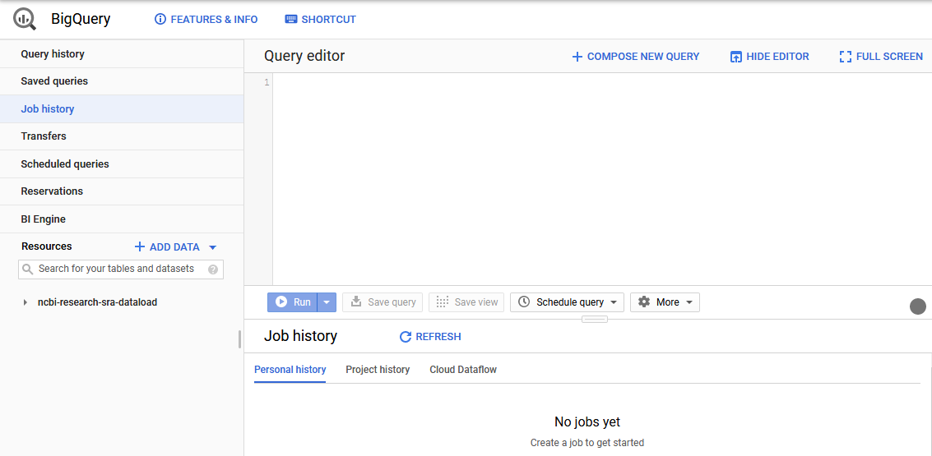
What is BigQuery?
BigQuery is the Google Cloud Data Warehouse product.
It supports features like queries, access control, and data management.
The Sequence Read Archive (SRA) maintains a copy of the sequence metadata from submissions in BigQuery
This allows SQL queries to search the metadata in ways that are hard or impossible with the NCBI Entrez search engine.
https://cloud.google.com/bigquery/docs/how-to

Slide 63
SRA in BigQuery?
There are multiple ways to interact with BQ.
In the background slides, there are GUI shots. That is one way to interact with the SRA data.
During the workshop we will use a command line call to dump the results of the STAT tool.
The query language is SQL.
The SRA data includes both metadata, similar to what you would see in Run Selctor, or downloading
SRA text files of metadata.

Slide 64
STAT
STAT is a tool that is still in development (the tool is not available yet)
similar to KRAKEN, it bins the SRA data into taxonomy hierarchy
SRA team has run this on all SRA data
results are available in the web, and in Big Query

Slide 65
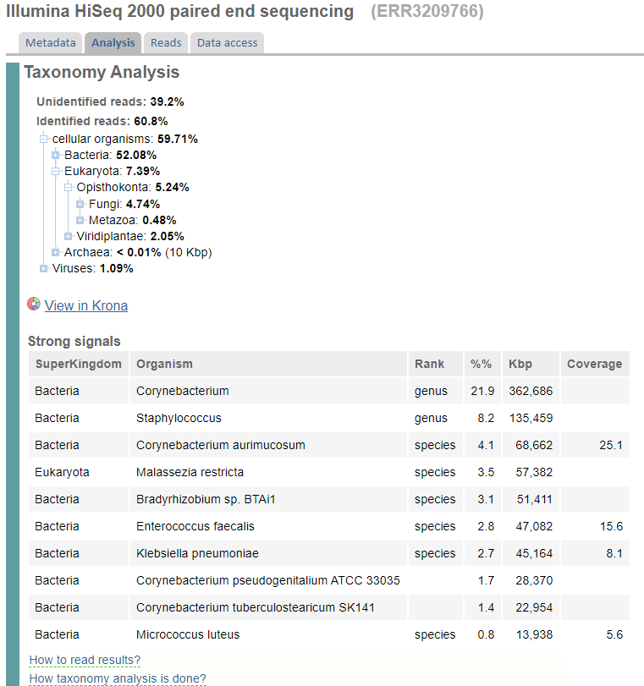
example of web presentation of STAT results
this has been used to identify Sars-Cov2 in sequences

Slide 66
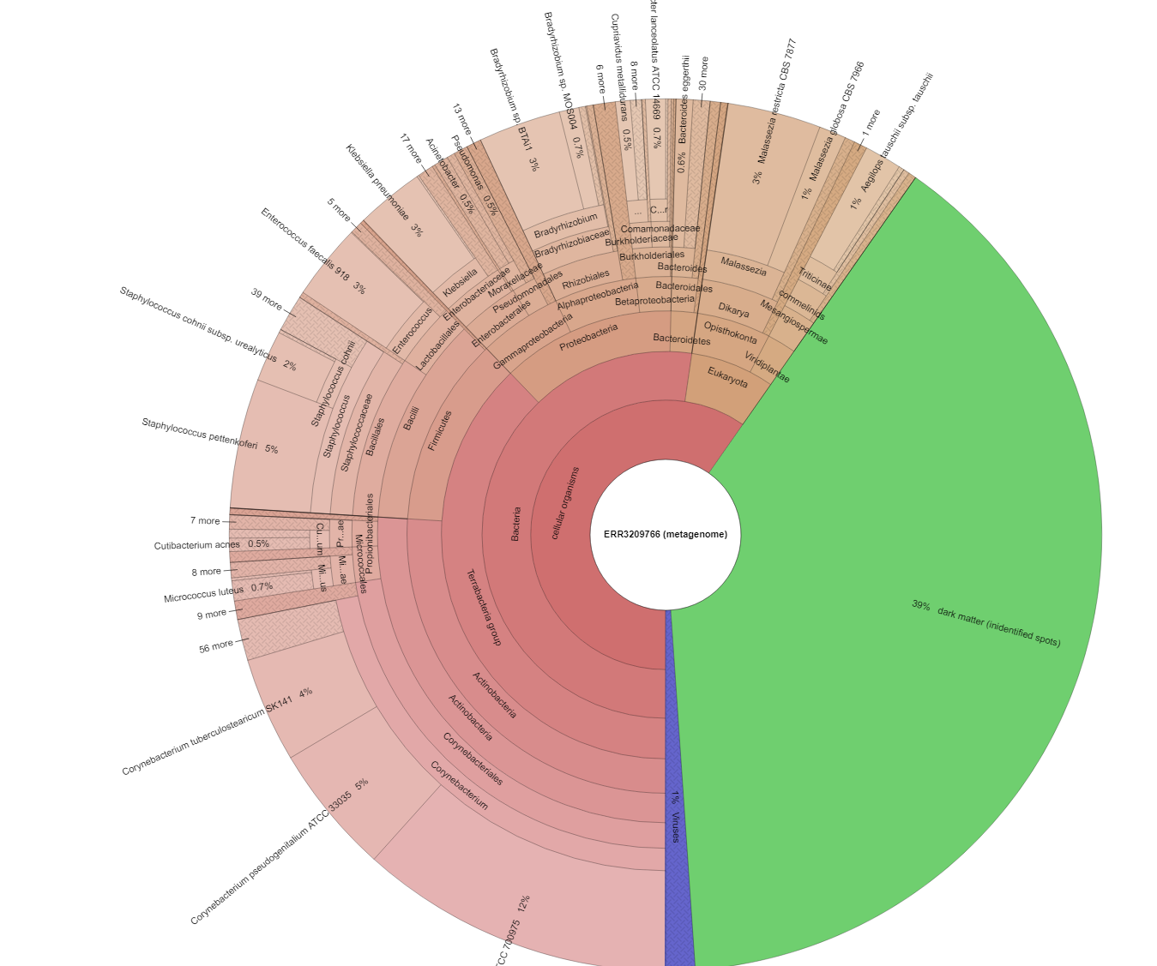

Slide 67
As plasmids and phages serve as an important medium for
the evolution and spread of ARGs and emergence of multidrug
resistance34,35, we characterized corresponding sequences in our
genomic database (Methods). In total, we recovered 696 Mb of
plasmid sequences .. most of which are not present in existing databases
for plasmids36 or phages37... Many closed plasmids were
>100 kb long (>9%, n = 536), rich in repeats and present at low
abundance, impeding characterization using Illumina metagenomics.
...
Culture-based enrichment in combination with long-read
metagenomics is powerful, enabling direct recovery of genomes
(chromosomal, plasmid and phage) without isolation.

Slide 68
The metagenome samples have been characterized for antibiotic resistance genes
that information was used to develop an enrichment plan using media containing antibitiocs
The culture enriched samples on antibiotic-containing media was then sequenced both
with nanopore and Illumina
Hybrid assemblies were built (Nanopore + Illumina data) using this information, and then binned into
plasmids, phage, genomes
We will take some of these plasmid sequences and compare to some of the metagenomics read sets

Slide 69
We will be using two tools
Readfinder
Efficient short nucleotide read filtering application.
SAUTE
Guided assembler
We will use readfinder used a pool of three plasmid sequences to extract reads matching those plasmid
sequences
We will then use SAUTE and the individual plasmids to built reference-guided assemblies
Both of these tools are undergoing active development, neither have been published

Slide 70
Once we finish the assembly we will check the coverage using blast
(how much of our new assembly covers the original plasmid)
And determine which metagenomics datasets have which plasmids

Slide 71
Back to Github

Slide 72
sort -nrk4 ERR3209766.plasmids.readfinder.p_1687.all.vars.fa.p_1687.bout | head p_1687:1:1:6370375 p_1687 99.050 101865 310 531 86344 188208 78190 179396 0.0 1.821e+05 p_1687:1:1:6370375 p_1687 98.980 78633 221 482 7476 86106 1 78054 0.0 1.402e+05 p_1687:2:1:1424386 p_1687 99.006 32907 89 202 7476 40382 1 32669 0.0 58737 p_1687:2:1:1424386 p_1687 99.237 7475 17 36 1 7475 188546 195980 0.0 13452 p_1687:1:1:6370375 p_1687 99.237 7475 17 36 1 7475 188546 195980 0.0 13452 p_1687:1:1:6370375 p_1687 98.970 1359 7 7 176222 177580 153647 154998 0.0 2425 p_1687:1:1:6370375 p_1687 98.896 1359 11 4 162321 163679 167458 168812 0.0 2423 p_1687:2:1:1424386 p_1687 99.394 825 2 3 7963 8786 186387 187209 0.0 1493 p_1687:1:1:6370375 p_1687 99.394 825 2 3 7963 8786 186387 187209 0.0 1493 p_1687:2:1:1424386 p_1687 99.391 821 2 3 7967 8787 182152 182969 0.0 1485 ## sort -nrk4 ERR3209768.plasmids.readfinder.p_1687.all.vars.fa.p_1687.bout | head p_1687:1:1:15260692 p_1687 98.799 126859 557 781 82 126924 480 126387 0.0 2.249e+05 p_1687:1:1:15260692 p_1687 98.782 34075 225 154 127172 161246 126649 160533 0.0 60451 p_1687:2:1:6079850 p_1687 99.054 21670 91 96 2 21671 160596 182151 0.0 38777 p_1687:2:1:6079850 p_1687 97.275 2092 54 3 20437 22528 180880 182968 0.0 3544 p_1687:2:1:6079850 p_1687 98.896 1359 8 7 6919 8277 153647 154998 0.0 2420 p_1687:2:1:6079850 p_1687 97.153 1124 32 0 20400 21523 181028 182151 0.0 1899 p_1687:2:1:6079850 p_1687 97.730 1013 23 0 20400 21412 181139 182151 0.0 1744 p_1687:2:1:6079850 p_1687 97.228 902 25 0 20400 21301 181250 182151 0.0 1528 p_1687:2:1:6079850 p_1687 99.513 821 2 2 21709 22529 186392 187210 0.0 1493 p_1687:2:1:6079850 p_1687 99.269 821 1 4 4641 5461 488 1303 0.0 1478 ## grep p_1687 ./hospital_microbiome/tables/antibiotics_gene_linkage.plasmid.tsv p_1687 12907 13380 DfrA1_Tmt p_1687 184283 184779 DfrA_Tmt p_1687 14756 15411 Qnr-S_Flq p_1687 170906 171741 StrB_AGly p_1687 170105 170906 StrA_AGly p_1687 176122 176993 CTX-M-1_Bla p_1687 10486 11756 TetA_Tet p_1687 194995 195832 SulI_Sul p_1687 169233 170044 SulII_Sul p_1687 172457 173313 TEM-1D_Bla p_1687 183090 183867 AadA_AGly p_1687 187556 188198 QnrB_Flq p_1687 192290 193422 DHA_Bla
the reference guided assemblies show very good coverage
of the original plasmid, and therefore the antimicrobial resistance
genes are covered very well

Slide 73
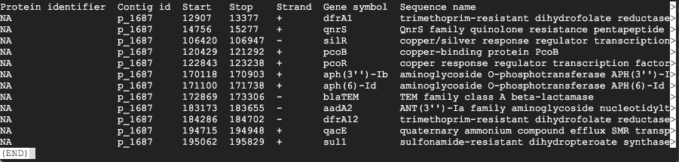
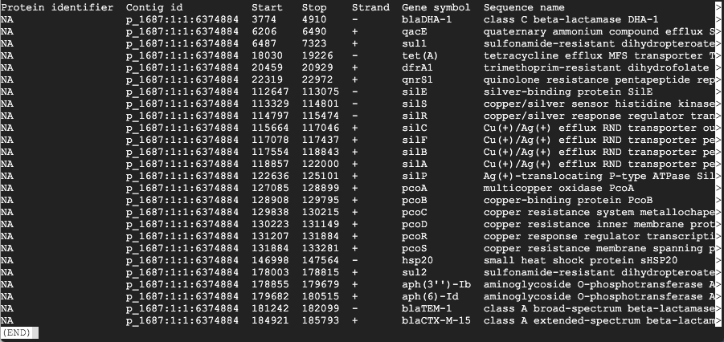
but
reference
what are these?
reference-guided assembly

Slide 74
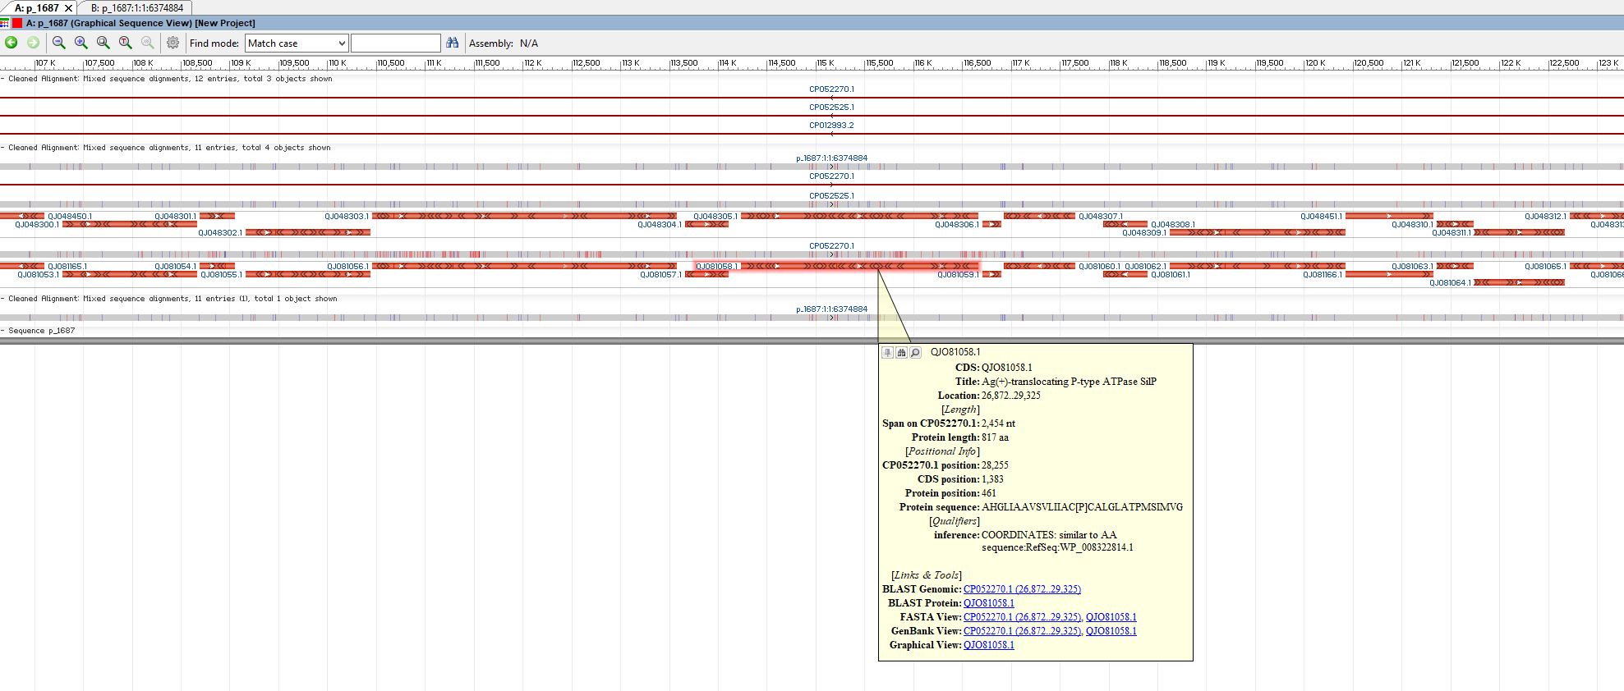
many tick marks (red - mismatch; blue - indel)
alignment of the reference plasmids against two plasmids from GenBank plus our SAUTE derived
plasmid

Slide 75
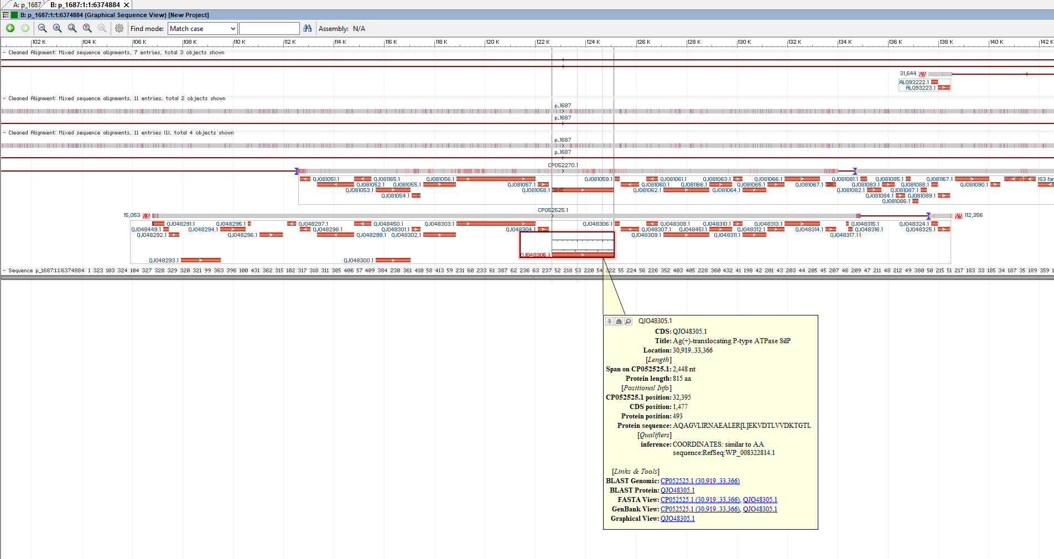
there are far fewer tick marks to CP052525
alignment of the SAUTE derived plasmid against same two plasmids from GenBank plus our original reference

Slide 76
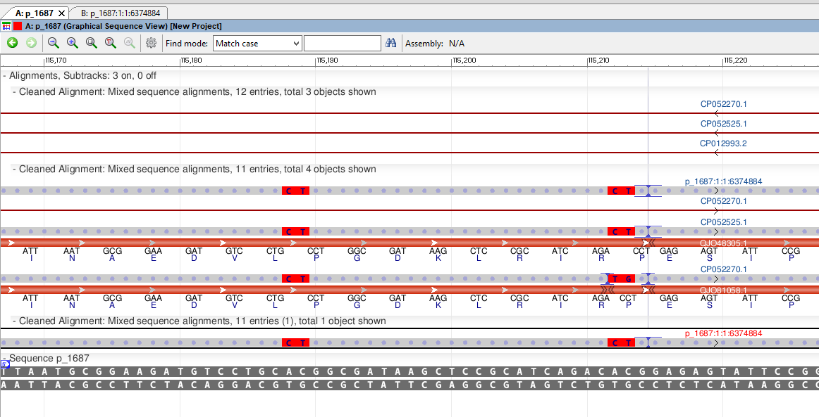
ref plasmid has multiple mismatches and indels in same place - suspicious - possibly
assembly or technology related

Slide 77
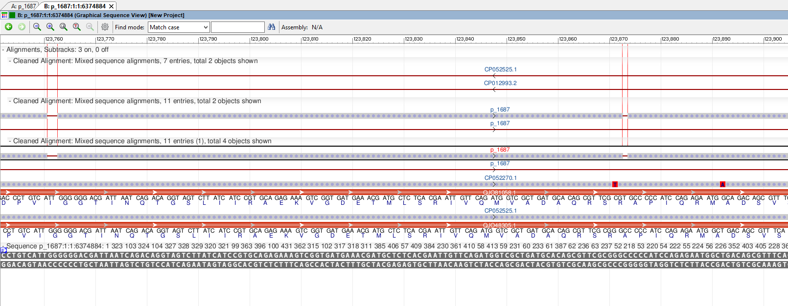
our derived plasmid does not have the same issues, two mismatches to one plasmid, and none to the
other, but clear indels against the refe plasmid

Slide 78
The reference plasmid (done with Nanopore) has significant mismatches and indels with respect to the plasmid we derived from a reference-guided assembly against that plasmid.
However, our reference-guided assembly appears much cleaner and more importantly matches
some plasmids in GenBank with higher identity, and lower indels, compared to the reference.
SAUTE, at least in this case, does not appear to 'duped' by the bad reference sequence and can result in high quality sequence assemblies (NOTE, we did not explore the graph genome files, we may see it there)

Slide 79
This may also mean that our gap in clades between s6 (nanopore sequenced) and the Kuwaiti isolates
(deposited already assembled) in project2 may have more to do with the technology and/or assembly method
May need to go back and attempt SAUTE assemblies of the Acinetobacter genomes (this may be
impossible with Illumina data for closely related isolates).

Slide 80
Reported Metadata of Metagenomics Samples from Paper (combined from multiple sources)
Date of Collection | Sample ID | Timepoint | Hospital Floor | Ward Type | Ward/Room Number | Sample Type | Bed Number | Surface Material | Illumina Library ID | SRR
2017-11-28 | HMBR127_02 | 2 | 8 | Isolation room | 3 | Bed Rail |  | Plastic | WEE037 | ERR3209766
2017-11-24 | HMBR133 | 1 | 11 | Isolation room | 5 | Bed Rail |  | Plastic | WEE039 | ERR3209768
2017-11-23 | HMBL103 | 1 | 7 | Standard | 3 | Bedside Locker | 5 | Wood | WEE120 | ERR3209849
2017-11-28 | HMA001_02 | 2 | 7 | MDRO | 1 | Aerator |  | Metal | WEE125 | ERR3209854
2017-11-24 | HMST007 | 1 | 9 | MDRO | 3 | Sink Trap |  | Metal | WEE237 | ERR3209966
both of these have the same/similar plasmids

Slide 81
Plasmids could be present due to being in the same host
or
The same plasmid is found in different hosts (different strains, different species)
How could you tell from a metagenomic sample?
If you were responsible for infection control in this hospital, what would you do with this information?

Slide 82
Summary: Project 3
In this project we introduced:
Step1. Reviewed the resistome data from the paper to filter down to particularly interesting metagenomics datasets
Step2. Used Big Query and SRA stat results to look at taxonomic distributions of the sequences from a few metagenomes
Step3. Obtained interesting plasmids, used Readfinder to pull out reads matching the plasmids, and assembled the reads
using SAUTE
Step4. Compared the resulting assemblies to the plasmids to determine which metagenomics datasets had which
plasmids and how well covered they were

Slide 83
FAIR Data
Findability, Accessibility, Interoperability, and Reuse of digital assets
Findable The first step in (re)using data is to find them. Metadata and data should be easy to find for both humans and computers. Machine-readable metadata are essential for automatic discovery of datasets and services, so this is an essential component of the FAIRification process.
The data from the paper was findable by following explicity links in the paper itself, NOT
from all other resources such as SRA.

Slide 84
FAIR Data
Findability, Accessibility, Interoperability, and Reuse of digital assets
Accessible Once the user finds the required data, she/he needs to know how can they be accessed, possibly including authentication and authorisation.
Once we found the data we could access it.

Slide 85
FAIR Data
Findability, Accessibility, Interoperability, and Reuse of digital assets
Interoperable The data usually need to be integrated with other data. In addition, the data need to interoperate with applications or workflows for analysis, storage, and processing.
However, to use it, we had to transform identifiers through multiple operatons in order to obain
the sequence data either in SRA, or on figshare

Slide 86
FAIR Data
Findability, Accessibility, Interoperability, and Reuse of digital assets
Reusable The ultimate goal of FAIR is to optimise the reuse of data. To achieve this, metadata and data should be well-described so that they can be replicated and/or combined in different settings.
Is this true?

Slide 87
FAIR Data
Findability, Accessibility, Interoperability, and Reuse of digital assets
Was the data in this paper FAIR or was it UnFAIR?
Imagine trying to reuse data from 10 different publications, all in 10 different places, or
formatted ten different ways.
Imagine how much time it would take to parse out the data so it could be searched, browsed,
integrated into bioinformatics workflows.

Slide 88
Summary: Workshop
Introduced some basic cloud concepts
Showcases some NCBI cloud-based tools and datasets
Used an existing published study to ask some questions
If you have further questions, email us at:
pd-help@ncbi.nlm.nih.gov

Slide 89
Acknowledgements
Richa Agarwala
Victor Ananiev
Azat Badretdin
Slava Brover
Joshua Cherry
Jinna Choi
Vyacheslav Chetvernin
Pavan Chilamakuri
Robert Cohen
Michael DiCuccio
Boris Fedorov
Mike Feldgarden
Lewis Geer
Renata Geer
Dan Haft
Lianyi Han
Avi Kimchi
Michel Kimelman
William Klimke
Alex Kotliarov
Valerii Lashmanov
Aleksandr Morgulis
Eyal Moses
Chris O'Sullivan
Arjun Prasad
Edward Rice
Kirill Rotmistrovskyy
Alejandro A. Schaffer
Nadya Serova
Stephen Sherry
Sergey Shiryev
Martin Shumway
Oleg Shutov
Douglas Slotta
Alexandre Souvorov
Tatiana Tatusova
Francoise Thibaud-Nissen
Igor Tolstoy Lukas Wagner
Hlavina Wratko
Chunlin Xiao
Alexander Zasypkin
Eugene Yaschenko Mingzhang Yang
David Lipman
James Ostell
Kim Pruitt
CDC
FDA/CFSAN
GenFS
USDA-FSIS
PHE/FERA
NHGRI
NIAID
WRAIR
Broad
Wadsworth/MDH
Vendors: PacBio, Illumina, Roche
pd-help@ncbi.nlm.nih.gov
This research was supported by the Intramural Research Program of the NIH, National Library of Medicine. http://www.ncbi.nlm.nih.gov
National Center for Biotechnology Information – National Library of Medicine – Bethesda MD 20892 USA

Slide 90
Survey
Please fill out the following survey to help us improve our workshops
https://forms.gle/U8sooNwut3NiuyQq6

